Slide 1

Happy Flyers, Higher Profits: Enhancing Airline Customer Satisfaction

Slide 2
PROJECT OUTLINE
1.
5.
Background
Recommendations and Solutions
2.
6.
Business Problem Analysis
Cost Profit Analysis
3.
7.
Naïve Approach
Risk & Mitigation
4.
8.
Data Science Task
Data Governance &
Closed-loop Ecosystem

Slide 3
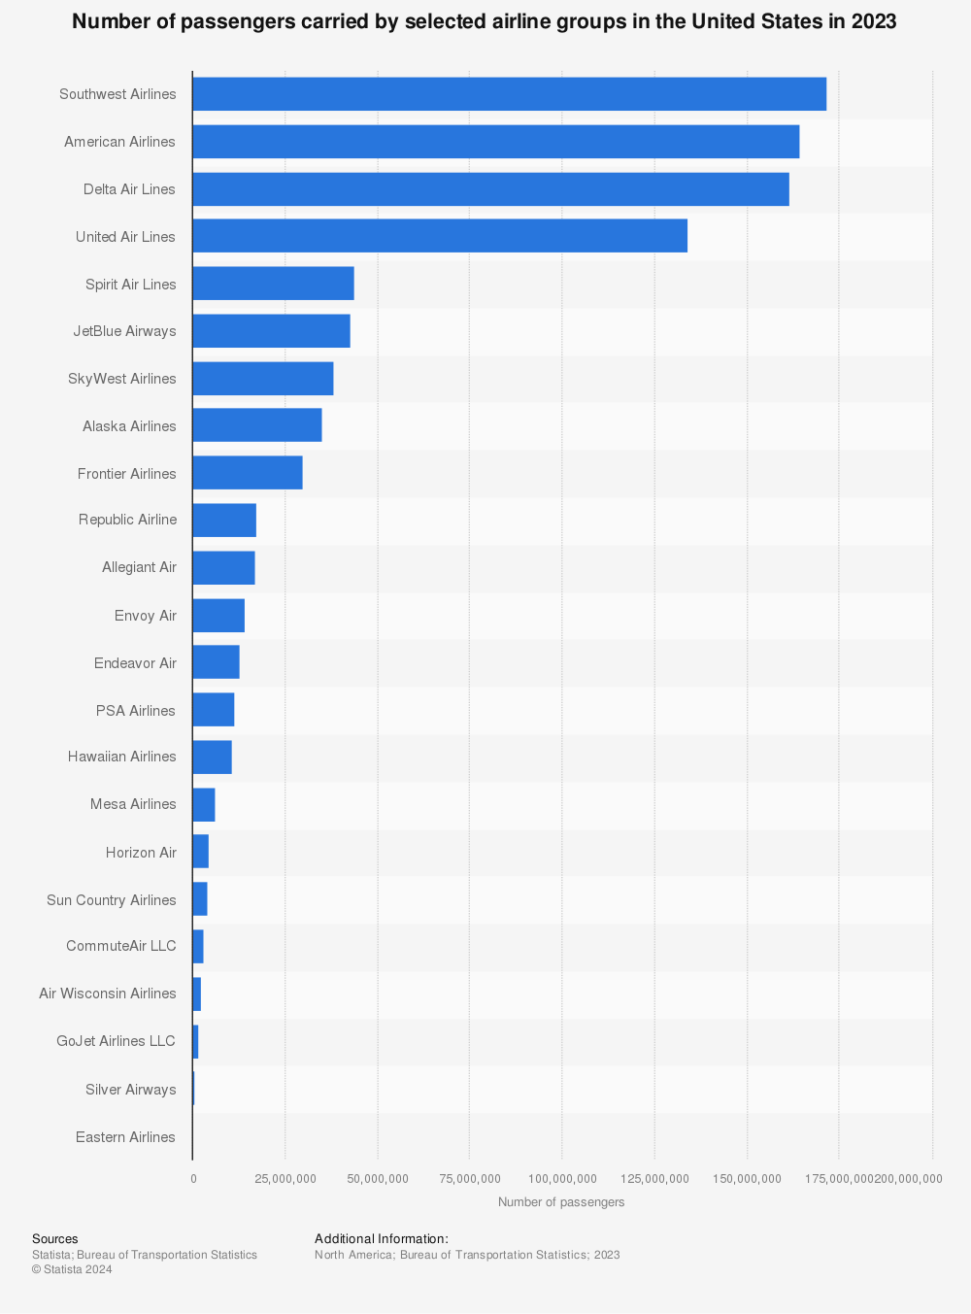
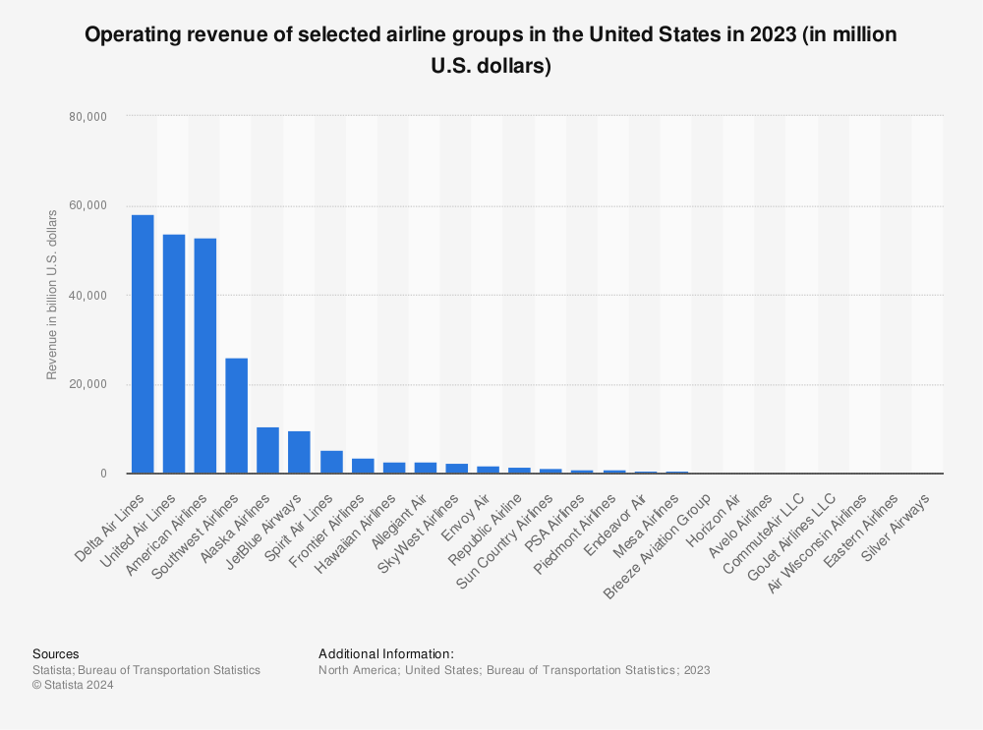
Background: Why is Profitability Important?
Southwest Airlines: 171.8 million passengers
American Airlines: 164.4 million passengers
Post-pandemic recovery
2023 REVENUE
Delta Airlines: USD 58.2 billion
United Airlines: USD 53.7 billion

Slide 4
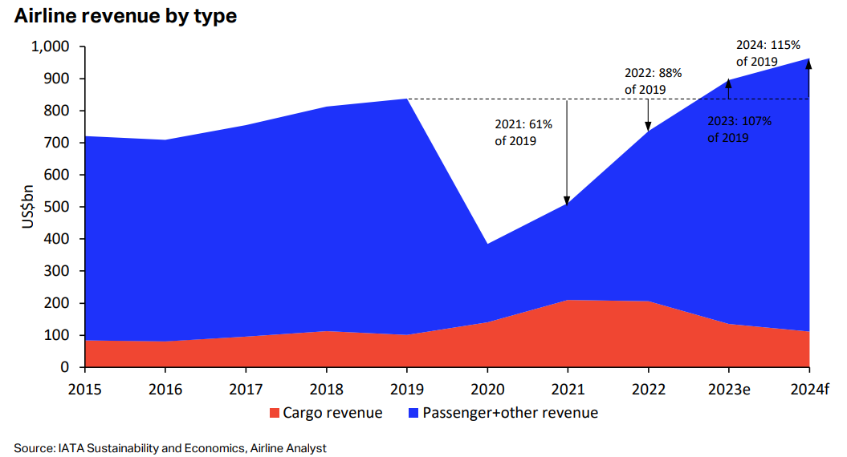
Background: Why Customer Satisfaction?
Passenger’s Revenue: Projected to reach 642 billion in 2023 (47% increase from 2022)
Pandemic loss: USD 140 billion
KEY FACTOR of Profitability : Passenger’s Satisfaction
https://www.iata.org/en/iata-repository/publications/economic-reports/airline-revenue-to-surpass-pre-pandemic-levels-in-2023/

Slide 5
Data Governance
&
Closed-loop Ecosystem
PROBLEM ANALYSIS
DATA SCIENCE TASK
RECOMMENDATION AND SOLUTION
COST ANALYSIS
RISK AND MITIGATION
NAÏVE APPROACH

Slide 6
Business Problem Analysis: Customer Journey
Awareness
Consideration
Booking
Marketing, Social Media, Travel Blogs
Research, Review, Compare airline prices
Airline website/
travel agency
Boarding
Airport Experience
Pre-flight
Boarding process,
Flight seat arrangement
Airport arrival, Security Check, Baggage drop
Online check-in,
Flight reminders
In-flight
Post-flight
Post-travel
Seat comfort,
In-flight Services
Baggage claim, Disembarking
Customer feedback, Loyalty programs

Slide 7
Business Problem Analysis: Mapping Customer Pain Points
Marketing
Airline Research
Website/ Travel Agent
Awareness
Consideration
Booking
Unclear info, difficulty finding reliable source
Fake reviews, lack of transparent pricing
Complex process,
Extra fees
Boarding Process
Baggage Drop
Online Check-in
Boarding
Airport Experience
Pre-flight
Crowded area,
Long waiting time
Long waiting time,
Overweight Fees
Technical Issue,
Limited Seat
Services
Disembarking
Feedback
In-flight
Post-flight
Post-travel
Limited legroom, limited food choices
Damaged luggage,
long waiting time
Complicated process,
Irrelevant offers

Slide 8
Business Problem Analysis: Airline Company
SWOT ANALYSIS [Strength, Weakness, Opportunities, Threats]
STRENGTH
WEAKNESS
OPPORTUNITIES
THREATS
> Weak Infrastructure
> High Cancellation Rate
> High Barriers to Entry
> High Competition
> High Cost
> Growth in Tourism
> Better Technology
> Expansion
> Increase in Competition
> Weather Risks
> High Profitability
> Safety and Speed
Notes:
Now we will see from airline company’s point of view. These are the strengths, weaknesses, opportunities and threats of an airline company. Airline is one of the safest and fastest transportation options for long journey, which is one of the strengths and airline industry also have high profitability overall. However, some issues that might be faced by the company are high cancellation rate, which is unpredictable, weak infrastructure, high barriers to entry, and also very costly and competitive. On the bright side, airline industry has a lot of growth opportunities, such as tourism, technology and business expansion. And finally, the threats of airline industry are the highly competitive nature and also weather risks, because weathers can be unpredictable and affect the flight experiences.

Slide 9
Business Problem Analysis: Findings
Vision: Optimizing travel with data science for smooth journeys and better profitability
Mission: To harness the power of data science to optimize airline profitability
Goals: Maximize Profitability, Increase Customer Satisfaction Level
Business Strategy: Focus on Customer Intimacy for higher profits
BUSINESS GOAL
“Enhancing Airline Profitability Through Customer Satisfaction”

Slide 10
Data Governance
&
Closed-loop Ecosystem
PROBLEM ANALYSIS
DATA SCIENCE TASK
RECOMMENDATION AND SOLUTION
COST ANALYSIS
RISK AND MITIGATION
NAÏVE APPROACH

Slide 11
Thought Process: Naïve Approach
SERVICE
Offer comprehensive services
1
6
INCREASE
Continuous improvement to boost profitability
FEEDBACK
To understand customers
2
IMPLEMENT
Focus on low-cost high-value areas
ACQUIRE
Attract new customers
3
5
MEASURE
Would customer recommend the airline to others?
4

Slide 12
Data Science Task: Why?
 | Data Science Approach | Naïve Approach
Precision and Accuracy | data-driven decisions | relies on assumptions
Scalability | handles big data efficiently (more scalable) | manual processes (less scalable)
Personalization | personalized recommendations | limited segmentations
Optimization | optimizes pricing strategies, dynamic model | static strategies, inefficient resources
Insight and Discovery | uncovers hidden pattern | surface-level analysis
Adaptability | adapts in real-time | adapts slowly
Customer Satisfaction | proactively resolves issues | reacts to issue after they arise

Slide 13

Data Governance
&
Closed-loop Ecosystem
PROBLEM ANALYSIS
DATA SCIENCE TASK
RECOMMENDATION AND SOLUTION
COST ANALYSIS
RISK AND MITIGATION
NAÏVE APPROACH

Slide 14
Data Science Task: Our Approach
EDA
APPROACH 1: Supervised Learning
APPROACH 2: Unsupervised Learning
1. Decision Tree
2. K-Means Clustering
> Identify Important Features that
relates to customer satisfaction
> Segment customers based on data features
Determine the most profitable features
3. Frequent Pattern Mining
Find Associations between features and satisfaction
Solutions and Recommendations

Slide 15
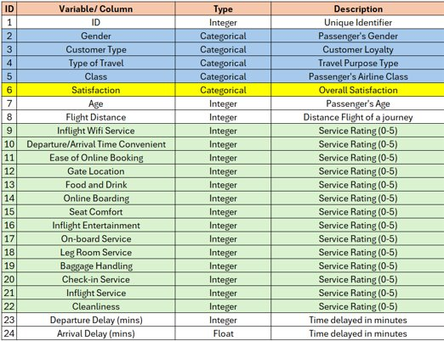
Data Science Task: Data Overview
Descriptive Analysis:
US Airline Passenger Satisfaction Survey Data (Kaggle)
Data Shape:
25 columns X 103,904 rows
Target Variable: Passenger Satisfaction
https://www.kaggle.com/datasets/teejmahal20/airline-passenger-satisfaction​
Notes:
Kaggle Dataset :
US Airline Passenger Satisfaction Survey Data
We have considered a dataset from Airline Passenger Satisfaction in Kaggle which is a modified data set from US Airline Passenger Satisfaction Survey Data (*Dataset links provided in reference)
Raw Data contains:
Rows: 103904 2) Columns: 25
Each row corresponds to one passenger, and each column to a specific feature.
Categorical columns: ['Gender', 'Customer Type', 'Type of Travel’ , 'Class','satisfaction’]

Slide 16
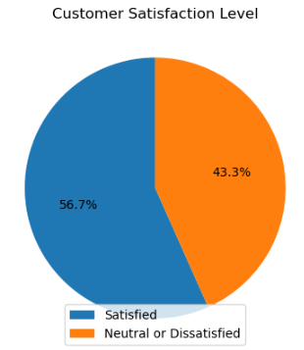
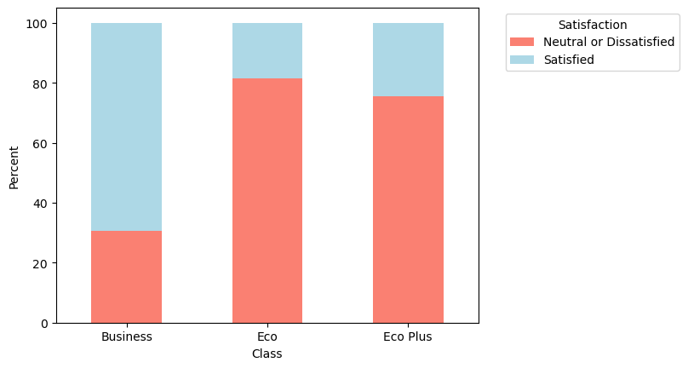
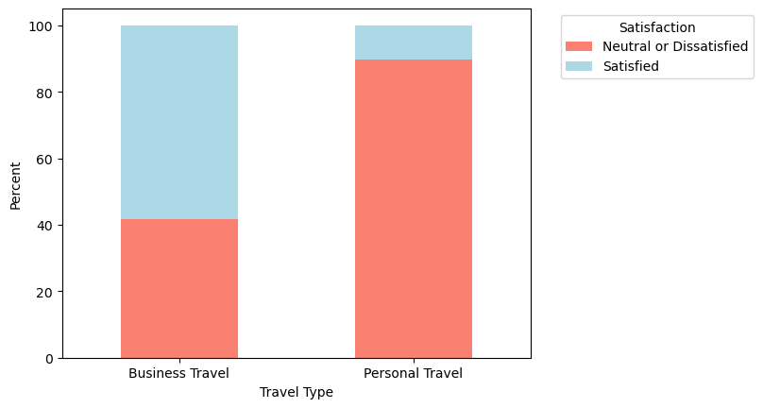
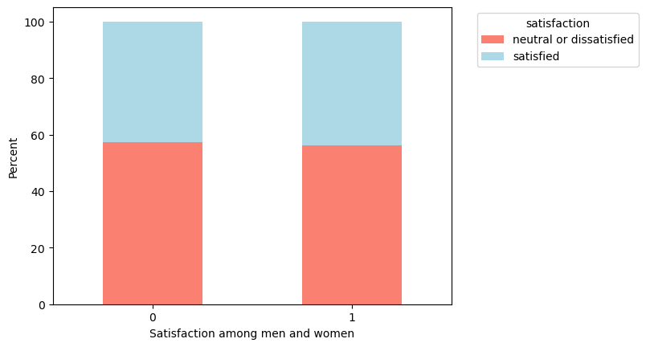
Data Science Task: Exploratory Data Analysis
TO ANALYSE THE TRENDS AND PATTERNS
Overall Satisfaction Level
Satisfaction based on Class
Satisfaction based on Travel Type

Slide 17
Data Science Task: Insights from EDA
 | ACTION | EXPECTED OUTCOME
Addressing General Dissatisfaction | develop targeted surveys | gain deeper insight on specific pain points
Upgrading Eco and Eco Plus Services | invest in improving features in eco and eco plus classes | positive experience for all traveller in general
Personalized Services for Different Travel Purposes | differentiate services based on travel purpose | passengers meet specific needs, enhancing satisfaction
Loyalty Program Enhancement | target potential high-profit customers using programs | increase customer retention, higher long-term profitability
Notes:
Overall Strategy : Based On EDA we decided to Combine Decision Trees and Clustering for Precision:
​ Use decision trees to identify key features influencing satisfaction and profit within each customer distribution And to use clustering to identify the highest dissatisfied cluster and target the influencing factors and customers groups for satisfaction and profitability.

Slide 18
DECISION TREE Identifying features that relate to and predict customer satisfaction using a decision tree.
Step 2
Step 4
Decision Tree Analysis
Customer Distribution in
Important Features
Step 1
Step 3
Extracting Important Features​
Model Performance

Slide 19
Data Science Task: Decision Tree
Decision Tree Model
Accuracy | Precision | Recall | F1-Score
0.95 | 0.96 | 0.95 | 0.95
Random Search
Confusion Matrix
Predicted Label
0 1
Best Parameters
Criterion: Gini
Max Depth: 20
Max Features: None
Min Samples Leaf: 2
Min Samples Split: 20
Actual Label
1 0
14144
429
740
10663

Slide 20
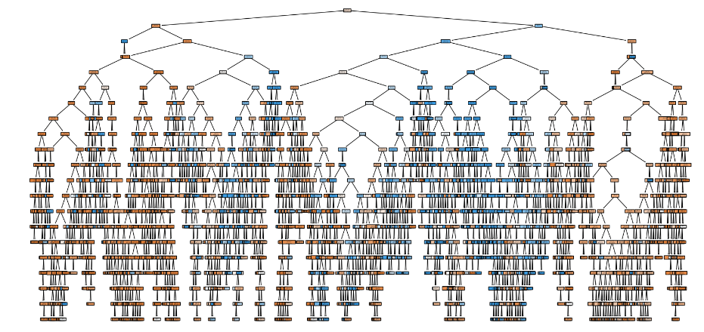
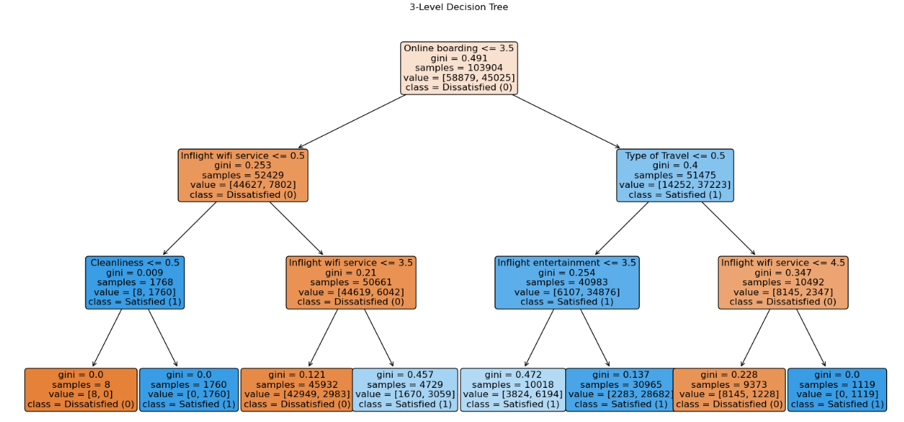
Data Science Approach: Decision Tree
Split Visualization

Slide 21
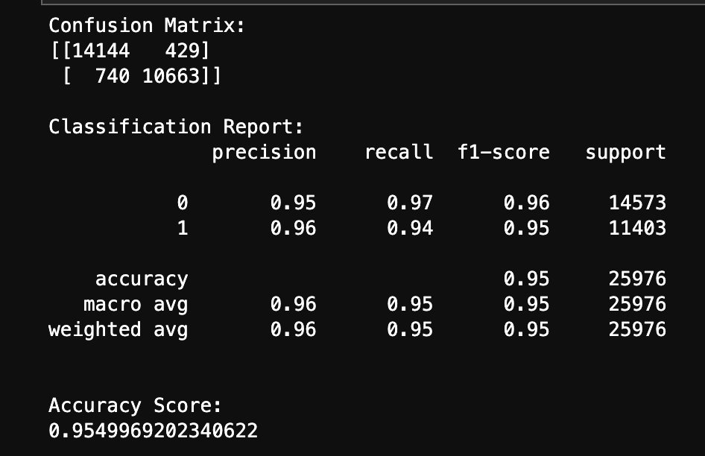
DECISION TREE​ MODEL
The accuracy of the decision tree analysis is 95% ​

Slide 22
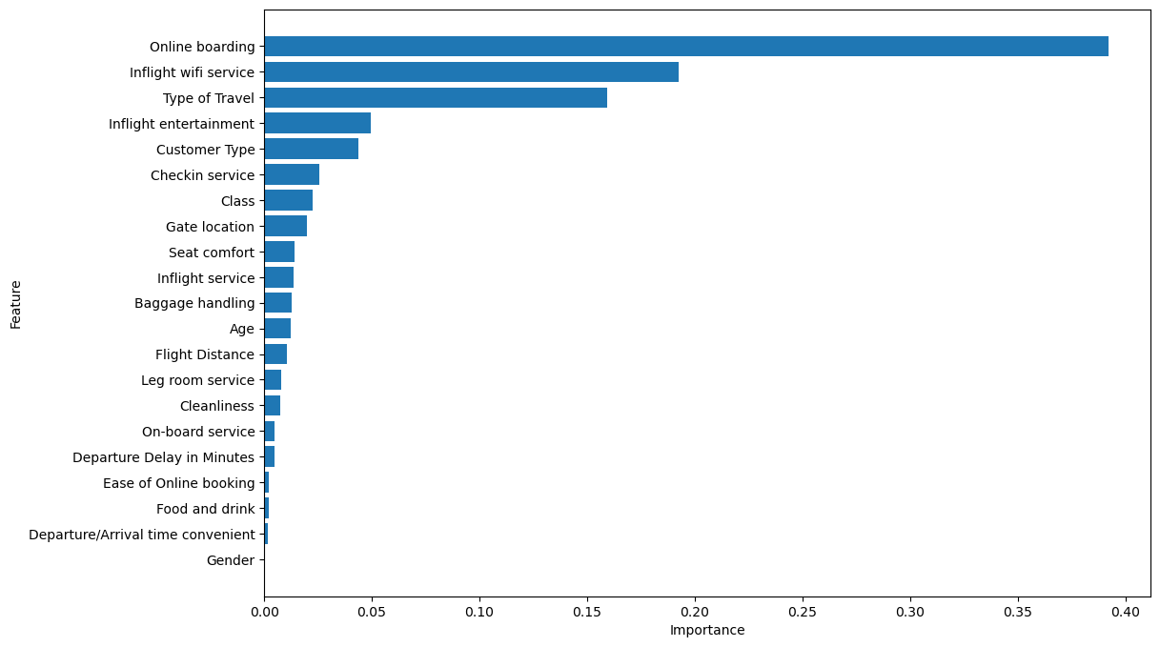
Data Science Task: Feature Importances
Feature Importances:
Inflight Wi-fi Service: 0.19
Type of Travel: 0.16
Online Boarding: 0.39

Slide 23
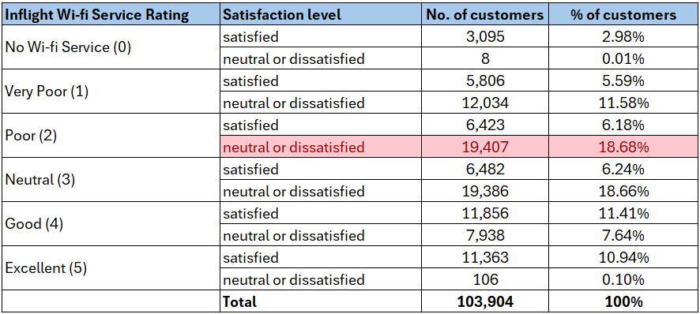
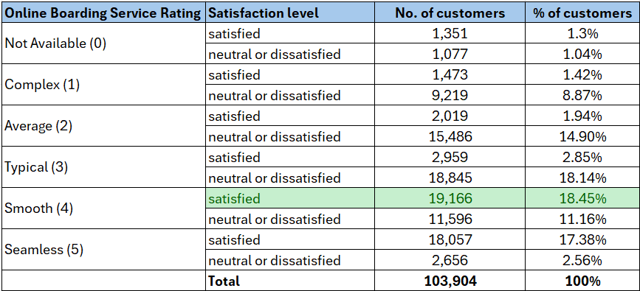
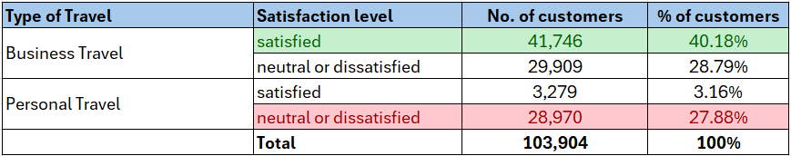
Data Science Task: Summary Statistics

Slide 24
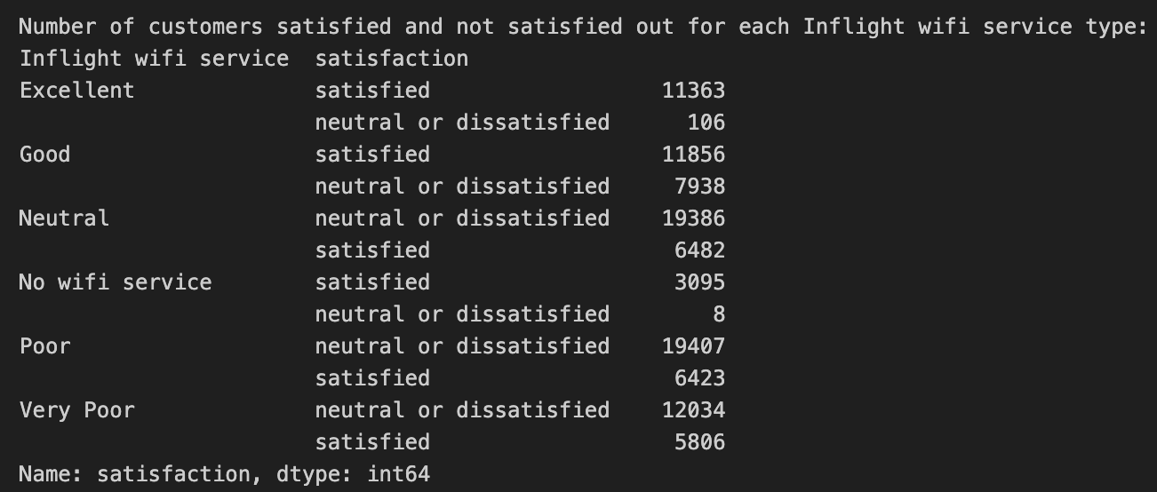
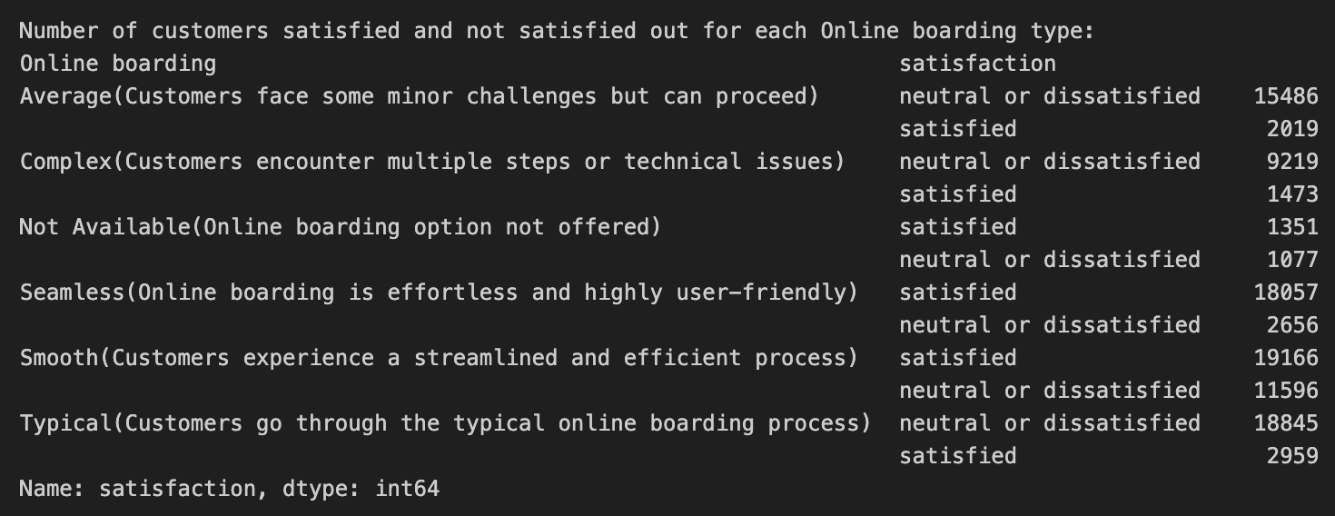
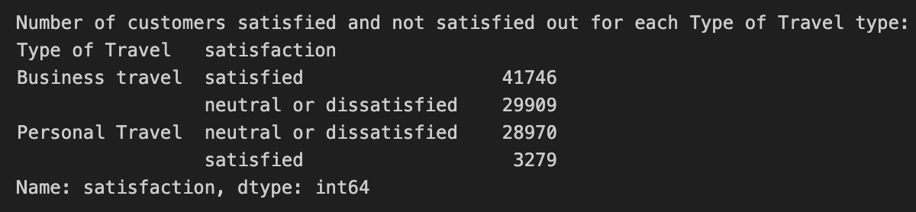
Data Science Task: Statistics of Decision Tree
This customer distribution gives us a basic understanding of determining factors for customer satisfaction

Slide 25
Segmentation process- To Segment customers based on data features using Clustering Analysis
Step 2
Step 4
Clustering Analysis
Identify key cluster characteristics
Step 1
Step 3
Determine ideal cluster count
Visualize distribution of different features within clusters
Notes:
This slide shows at high level, the steps performed for doing segmentation.
Step 1: Using elbow method to determine the ideal cluster count
Step 2: Apply K-means clustering using the determined cluster count.
Step 3: Visualising and profile different data features within the clusters
Step 4: Based on the profiling, identify characteristics of each cluster.

Slide 26
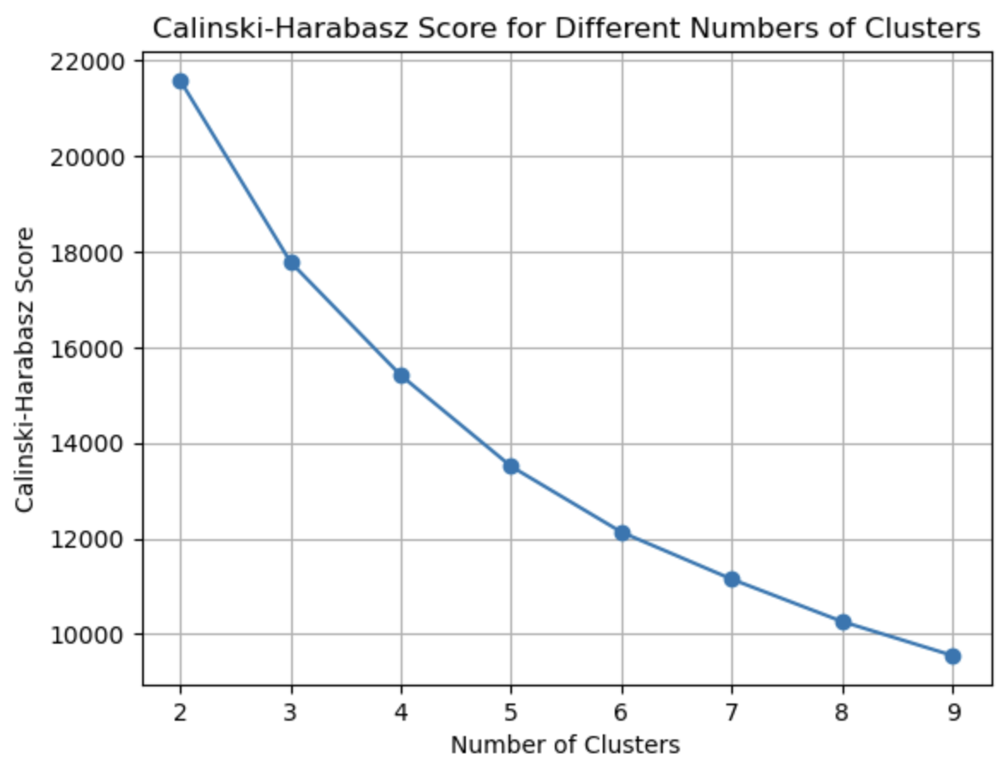
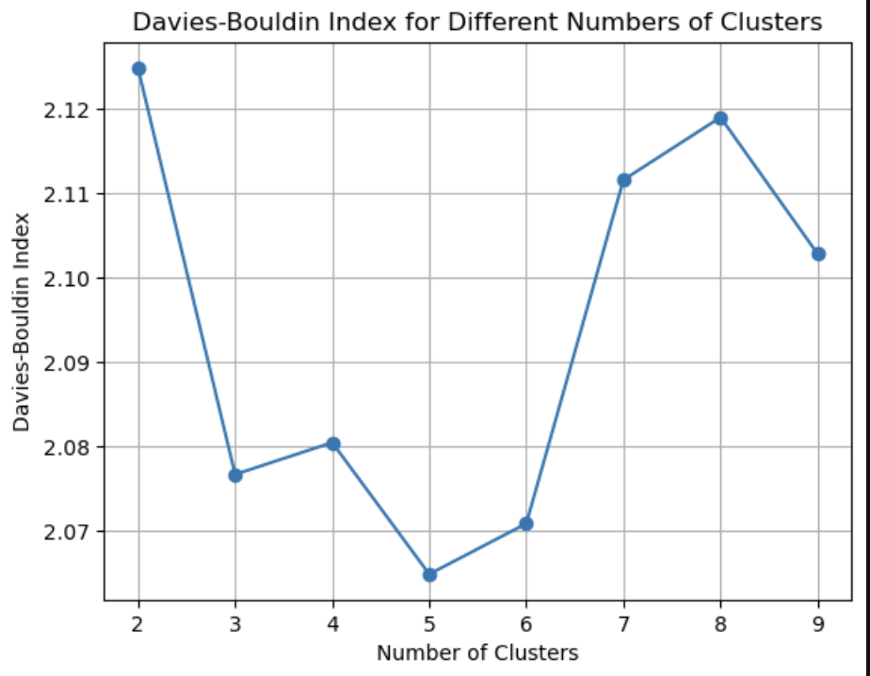
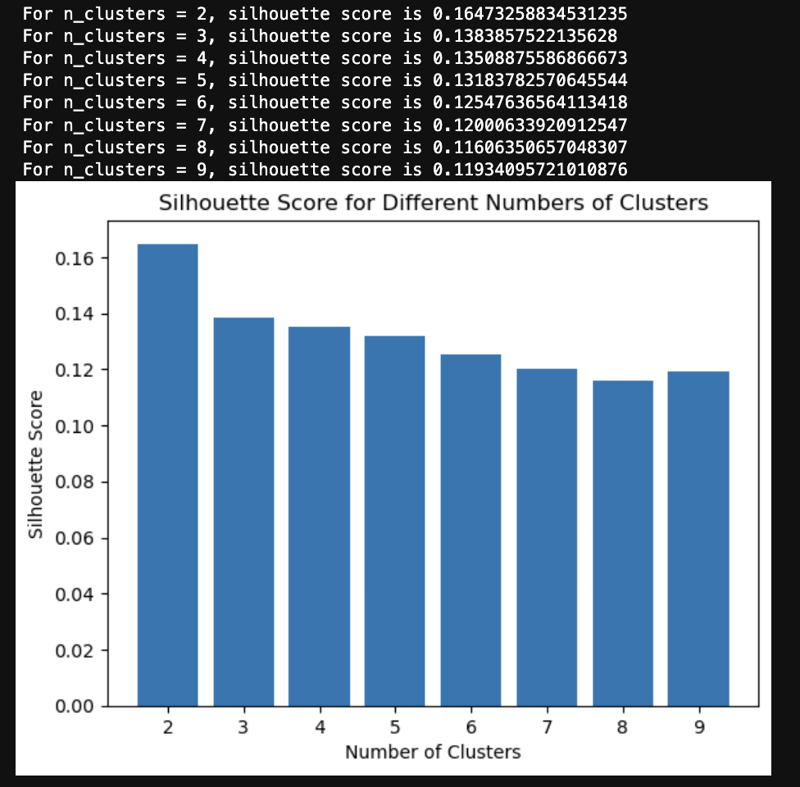
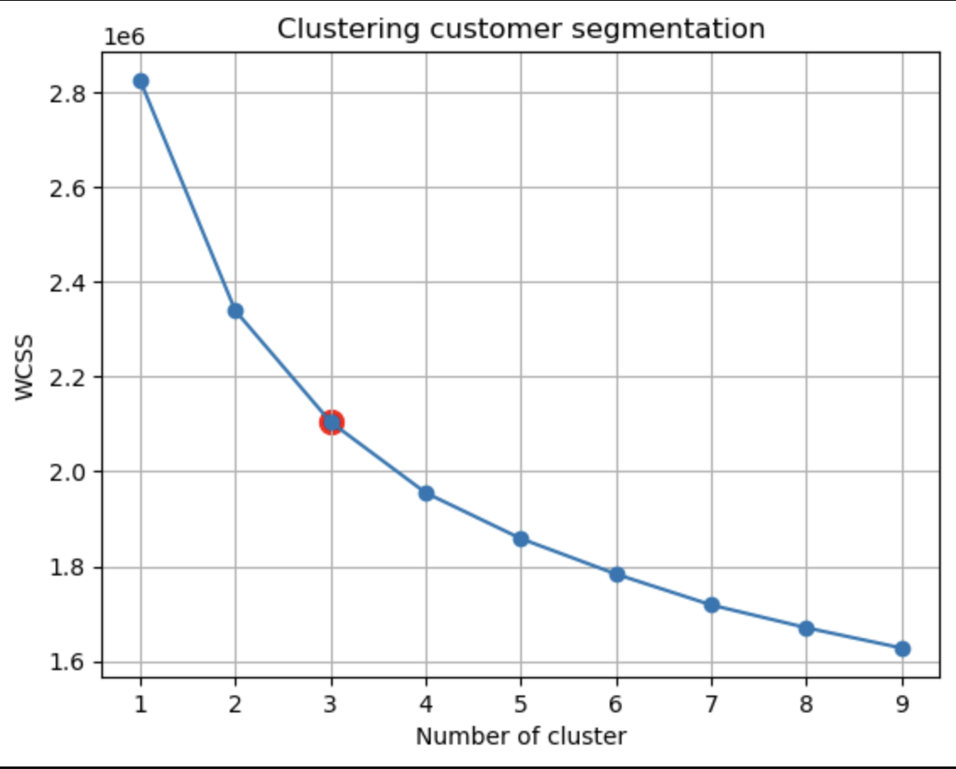
Data Science Task : To Segment customers based on data features using Clustering Analysis
Identifying the Ideal Number of Clusters

Slide 27
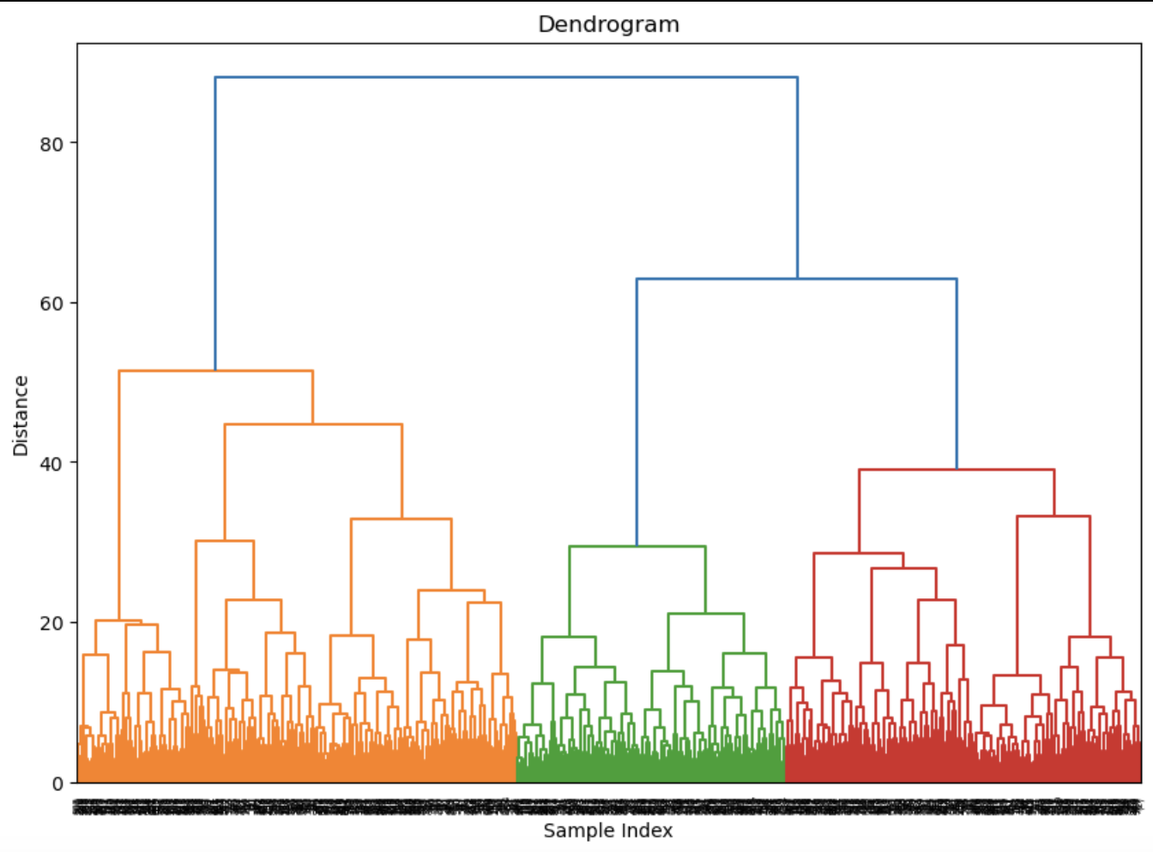
Hierarchical clustering(Data Visualization)
Decision: optimal number of clusters is 3 clusters
​K-means:
Used K-means++ elbow method to determine optimal clusters, with WCSS indicating 3 clusters as preferable.
Silhouette Score:
Silhouette score leaned towards 2 clusters, highlighting cohesion and separation but not fully capturing clustering dynamics.
Quantitative Evaluation:
Explored additional metrics: Calinski-Harabasz score and Davies-Bouldin index to look into separation of clusters
Calinski-Harabasz score and Davies-Bouldin index offered balanced insights into compactness and separation of clusters.
Preference for 3 Clusters:
K-means elbow ,Calinski-Harabasz score and Davies-Bouldin index supported 3 clusters as optimal, balancing
within-cluster and between-cluster dispersion.
Dendrogram visualization corroborated preference for 3 clusters, capturing underlying relationships effectively.
Conclusion:
Decision for 3 clusters based on thorough analysis of multiple metrics, ensuring a well-rounded understanding of
clustering dynamics.

Slide 28
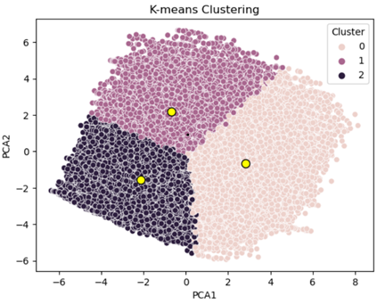
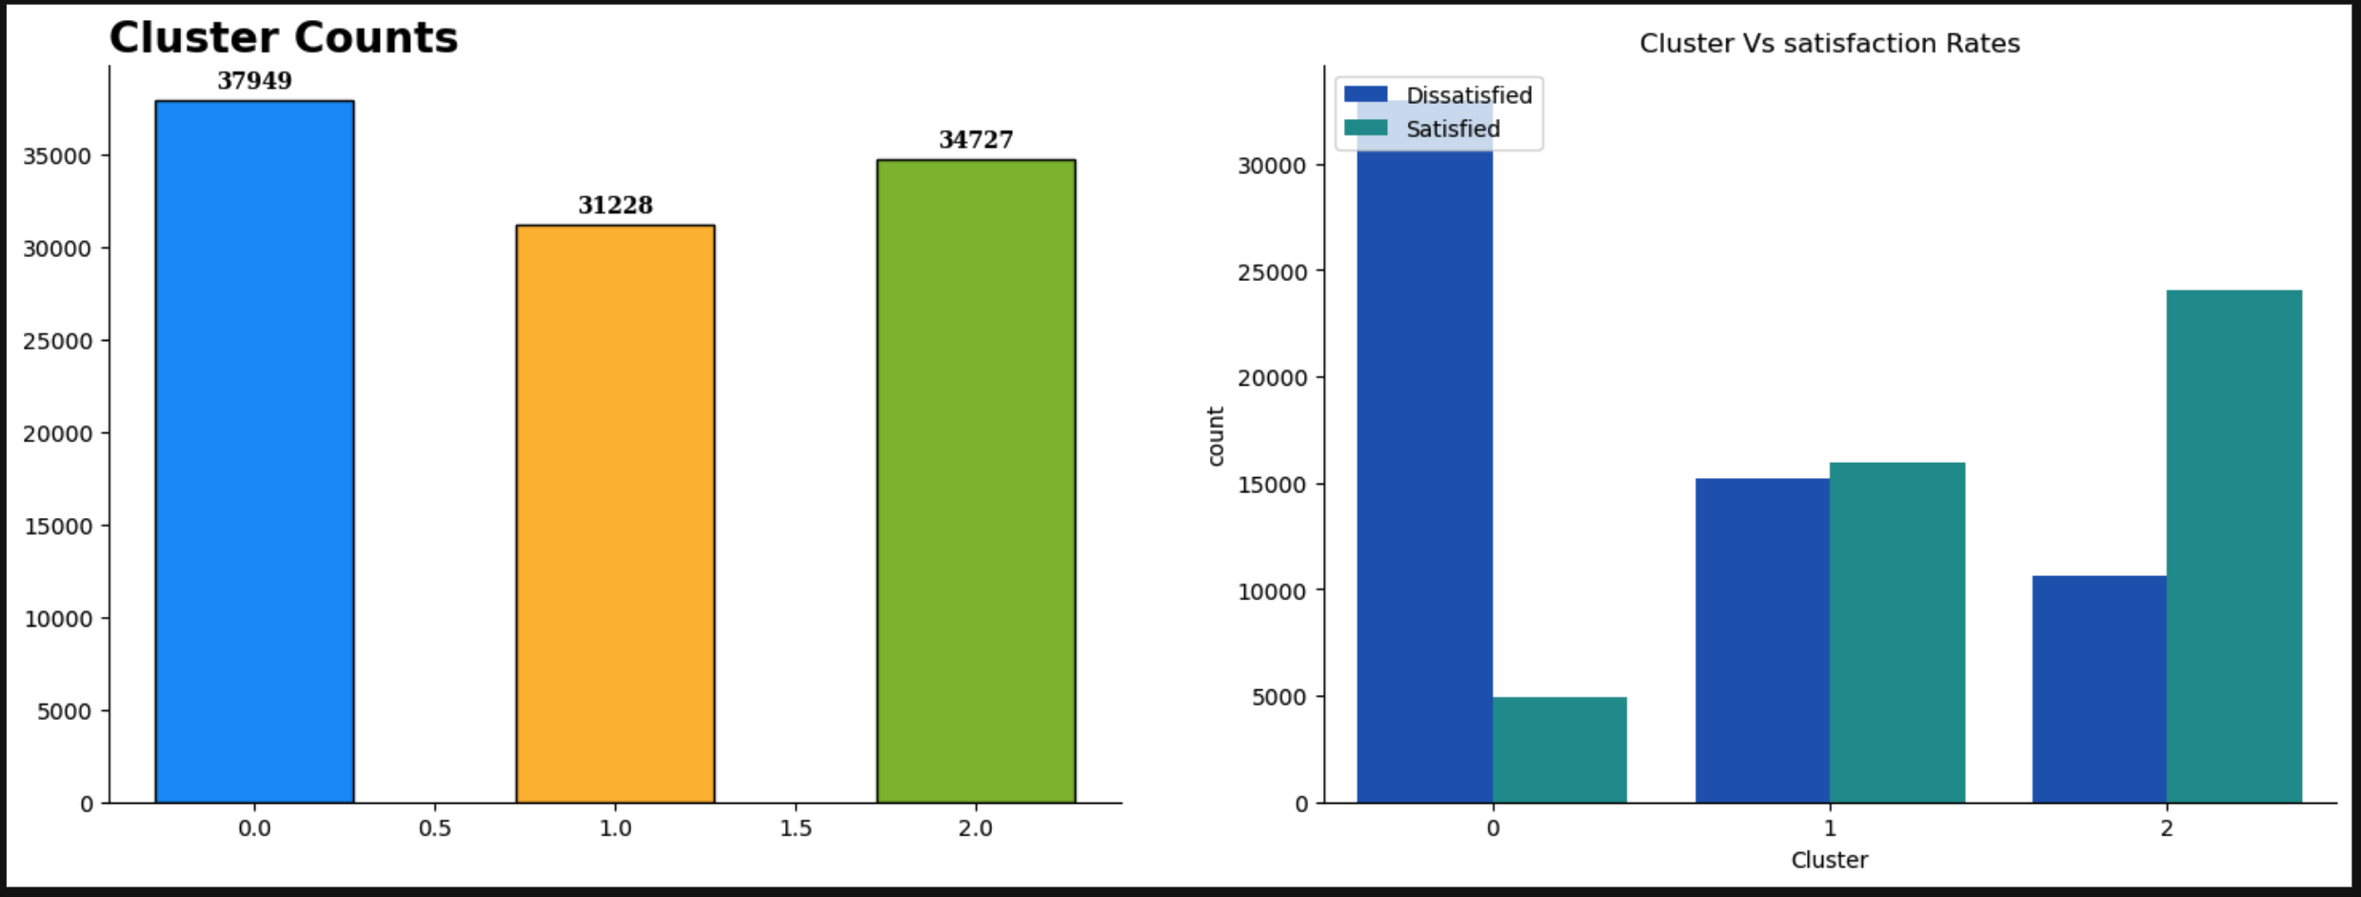
Data Science Task: K-means Clustering
Step 2: K-Means Clustering
Cluster 0 is the biggest cluster
Cluster 0 is found to be biggest cluster followed by 2 and 1

Slide 29
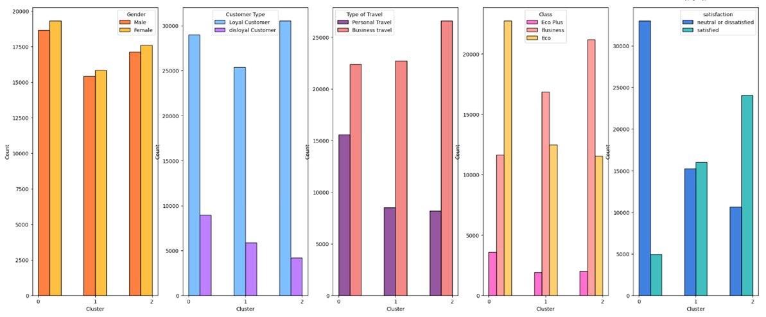
Data Science Task: K-Means Clustering
Step 3: Visualize and Identify Cluster Characteristics
Distribution of categorical variables across clusters​

Slide 30
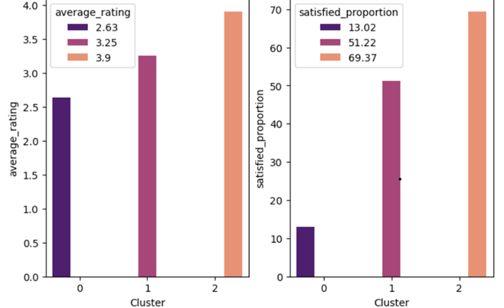
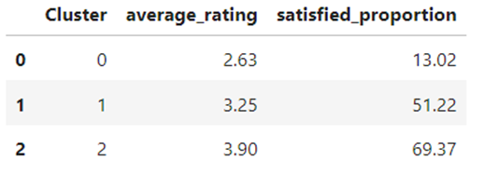
Cluster visualization and profiling
Average passenger rating vs Customer satisfaction
It is seen that higher service rating corresponds to higher satisfaction
Notes:
In this slide, the average service rating by passenger is compared against satisfaction. It is seen that higher rating is corresponding to higher satisfaction rating.

Slide 31
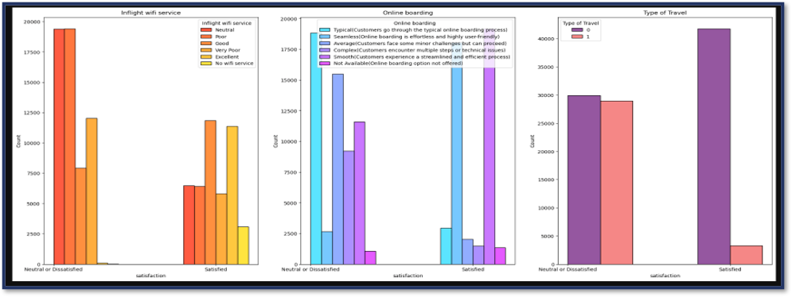
Data Science Task: Determine the Most Profitable Features
WE FOUND THE THREE TARGETABLE FEATURES CATEGORISING ALL CUSTOMERS USING DECISION TREE
Notes:
Finally, based on the profiling we characterise the cluster.
Cluster 0 - Economy Travelers with Low Satisfaction
- Disloyal, personal travelers; mostly in Economy class.
- Highest dissatisfaction, lowest ratings, shorter trips.

Slide 32
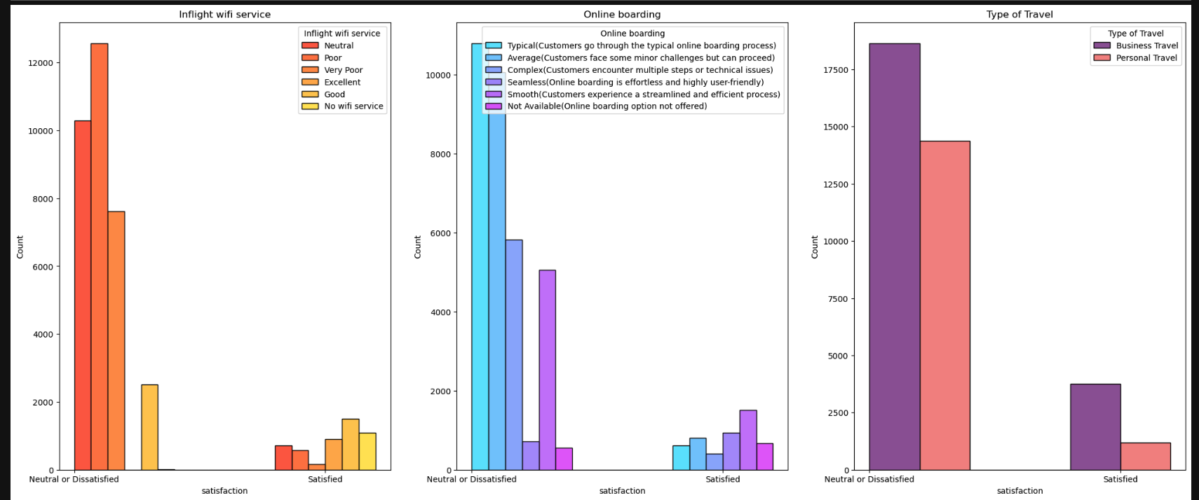
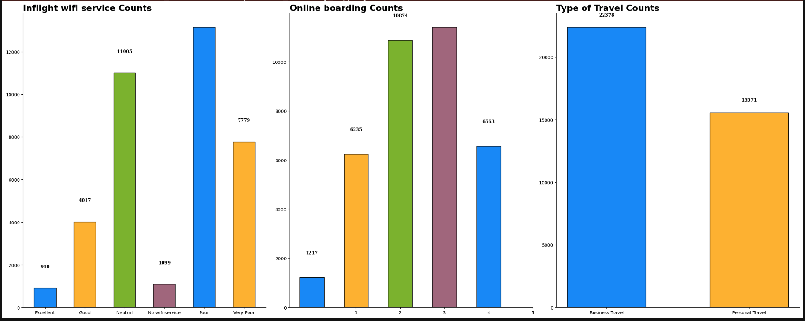
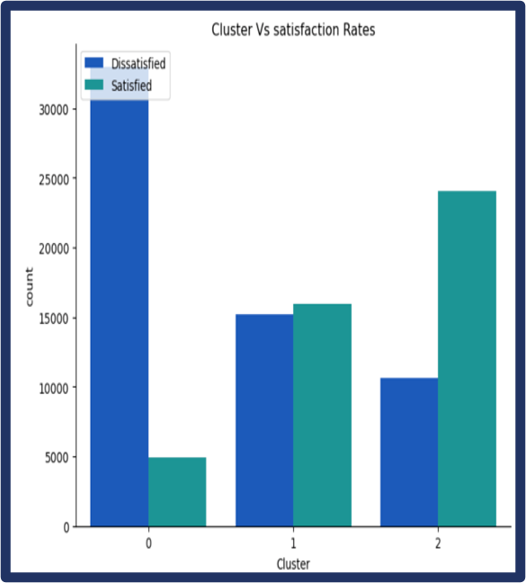
Data Science Task: Determine the Most Profitable Features
Analyzing the distribution of the 3 targetable features from Decision Tree in Cluster 0 obtained from K-means clustering
"Analyzing the distribution of three important features in cluster zero" ​
We found cluster zero has highest dissatisfaction and highest number of customer count ​

Slide 33
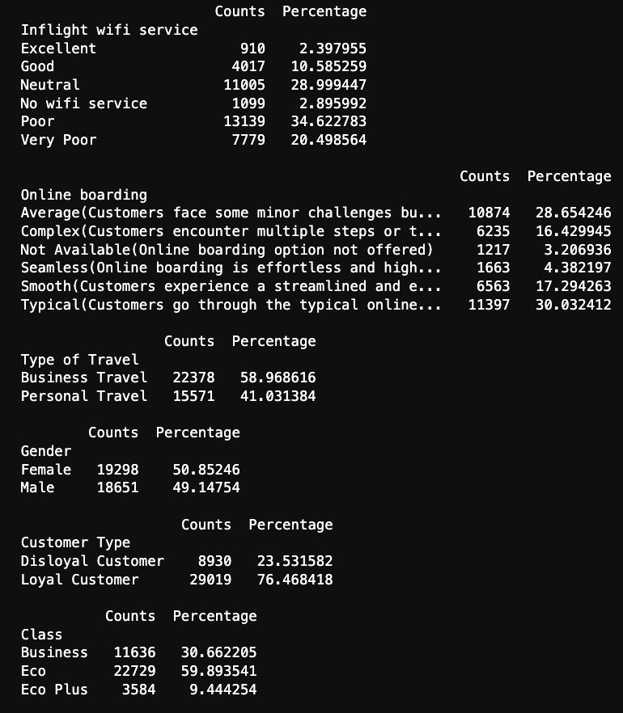
Statistics of cluster analysis To identify the customer groups that we can target

Slide 34
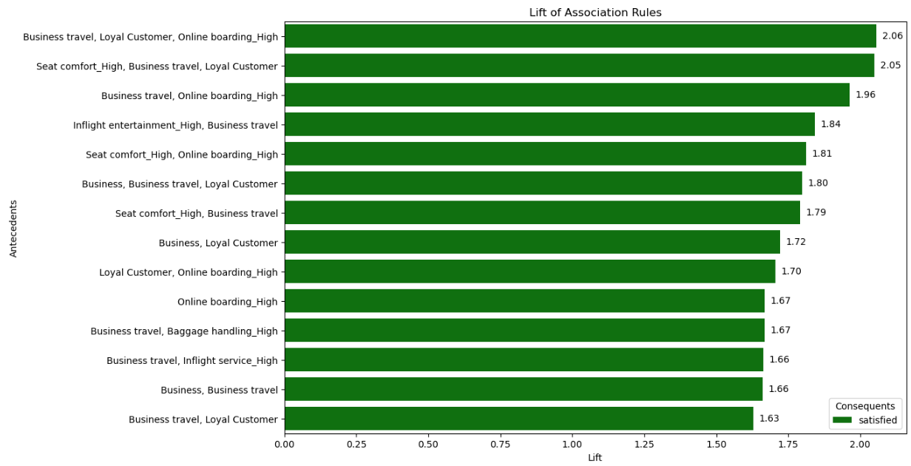
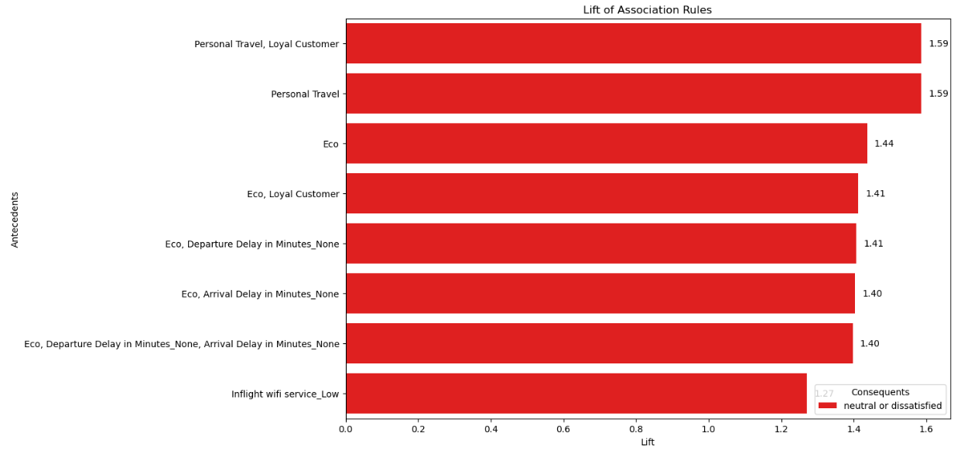
Data Science Task: Frequent Pattern Mining and Association Rules
Notes:
This analysis employs data preprocessing, frequent itemset generation, and association rule mining to explore the relationships between service features and passenger satisfaction. The data preprocessing stage includes segmenting various service ratings and delay times into meaningful categories like 'Low', 'Medium', 'High', and categorizing age into groups such as 'Child', 'Young Adult', 'Adult', 'Senior' and flight distance into group such as 'Short', 'Medium', 'Long', 'Very Long'. One-hot encoding is then used to convert these categories into a numerical format suitable for pattern mining.
The Apriori algorithm is applied to generate frequent itemsets, followed by the derivation of association rules. These rules are filtered to focus on those that have a direct impact on passenger satisfaction, specifically looking for rules where the consequences are either 'satisfied' or 'neutral or dissatisfied'.
The visualization of these rules through a lift-based bar chart provides clear insights. Rules associated with 'Business travel', 'Loyal Customer', and 'High Online boarding' show a significant positive impact on satisfaction, highlighted by high lift values, suggesting that loyal business travelers who experience convenient online boarding processes are more likely to be satisfied. Conversely, rules involving 'Personal Travel' with or without the 'Loyal Customer' tag show lower satisfaction levels, as indicated by the red bars. This analysis not only helps in identifying key drivers of passenger satisfaction but also in pinpointing areas where improvements can be made to enhance customer experience.

Slide 35
Data Governance
&
Closed-loop Ecosystem
PROBLEM ANALYSIS
DATA SCIENCE TASK
RECOMMENDATION AND SOLUTION
COST ANALYSIS
RISK AND MITIGATION
NAÏVE APPROACH

Slide 36
LINKING BACK TO OUR BUSINESS PROBLEM ANALYSIS
CUSTOMER PAINPOINTS
Booking
Boarding
Inflight
Post Travel
COMPANY_SWOT_OPPURTUNITIES
Better Technology
Expansion
DATA SCIENCE TASK
Provide data-driven solution and recommendation
Identify customer pain points
Profit gain opportunity
Notes:
Based on data science analysis .We are providing Solutions and recommendations for these customers pain points and suggesting opportunities for the company profit gain
Our analysis has identified key pain points across the customer journey—from booking and boarding to inflight services and post-travel experiences. These insights not only highlight challenges but also present significant opportunities.
We are poised to leverage advanced technology to enhance customer interactions at every touchpoint, ensuring a seamless and satisfying experience. Additionally, our planned expansions are aimed not just at increasing our geographic reach but also at enhancing our service offerings and digital capabilities.
The path forward involves utilizing sophisticated data science techniques to pinpoint exact areas for improvement and provide clear, actionable solutions that effectively address customer needs.

Slide 37
Data Science Recommendations and Solution
1. Improve In-flight Wi-fi Services – Decision Tree
Identified Issue: highest dissatisfaction passengers under the poor category
Recommendations: improve wi-fi stability, wi-fi Availability on smaller airplanes
2. Improve Online Boarding Experience – Decision Tree
Identified Issue: highest dissatisfaction passengers under the average category
Recommendations: simplify the process, analyze passengers’ habits, provide assistance for passengers
3. Offer Personalized Services – Clustering Analysis
Identified Issue: shows higher dissatisfaction passengers with highest number of customers
Recommendations: identify the characteristics of customers in cluster 0 and offer personalized services
4. Offer Loyalty Program – Frequent Pattern Mining
Identified Issue: loyal customer and personal travellers are highly dissatisfied
Recommendations: offer benefits and loyalty program to enhance the loyal customers
Notes:
Analyze passengers’ habit: frequent pattern mining
Point 4: identified from the frequent pattern mining
We have pinpointed specific areas for improvement through rigorous data analysis. First, we aim to enhance our in-flight Wi-Fi services, focusing on the stability and availability on smaller aircraft where dissatisfaction is most pronounced. Next, we recognize the need to streamline our online boarding process, making it simpler and more intuitive based on passenger habits and feedback.
Furthermore, we are committed to offering personalized services by analyzing customer behavior to tailor our offerings to meet diverse needs. Lastly, we will strengthen our loyalty program to ensure our frequent travelers receive the recognition and benefits they deserve.

Slide 38
Recommendation
Strategic Optimization
Data-Driven Service Enhancements
Customer Feedback Integration
Identify Key Pain Points
Targeted Marketing Campaigns
Continuous Monitoring and Feedback
Personalized Communication
Loyalty and Rewards Programs
Operational Improvements
Maintain High Service Standards
Personalize Services
Reward Loyalty
Invest in Technology
Staff Training
Notes:
The last business question, How do we optimize business strategies towards different customer groups from historical data analysis, we can speak of the following four parts.
Data-Driven Service Enhancements:
Identify Key Pain Points: For Cluster 0, focus on economy class and WiFi improvements; for Cluster 1, enhance loyalty benefits and business travel services; for Cluster 2, maintain and personalize high-quality services.
Targeted Marketing Campaigns: For example, promote upgraded economy class features to Cluster 0, highlight loyalty program benefits to Cluster 1, and offer exclusive perks to Cluster 2.
2. Customer Feedback Integration:
Continuous Monitoring and Feedback: Regularly collect and analyze customer feedback to understand changing preferences and satisfaction levels. Implement a feedback loop where improvements are continuously made based on the latest data.
Personalized Communication: Engage with customers through personalized communication, ensuring that their feedback is acknowledged and acted upon. This can be through emails, surveys, or direct interaction during flights.
3. Loyalty and Rewards Programs:
Tailored Loyalty Programs: For instance, offer business travelers exclusive access to airport lounges and priority services.
Incentivize Feedback Participation: Encourage customers to participate in feedback surveys by offering incentives such as bonus miles, discounts on future flights, or entry into prize draws.
4. Operational Improvements:
Invest in Technology: Enhance the overall customer experience by investing in technology that improves service delivery, such as automated check-in systems, high-speed inflight WiFi, and personalized entertainment options.
Staff Training: includes customer service training, technical training for using new systems, and sensitivity training to handle diverse customer needs effectively.

Slide 39
Recommendation
Targeted Service Improvements
Economic Class
Mixed Cabin Business
Improve Inflight Service Quality
Upgrade Economy Class Comfort
Enhance WiFi Service
Increase Loyalty Programs
Optimize Business Travel Services
Consistent Quality Across Cabins
Loyal Business Travelers
Maintain High Service Standards
Personalize Services
Reward Loyalty
Notes:
For the second question, what are the services that can be improved for different customer groups to increase customers’ satisfaction level.
Economic Class Low Satisfaction Travelers:
Inflight Service Quality: Improve meal options, cabin crew attentiveness, and service efficiency.
Economy Class Comfort: Enhance seat comfort with more legroom, better cushioning, and ergonomic designs.
WiFi Service: Provide reliable, high-quality WiFi as its lack significantly reduces satisfaction.
Mixed Cabin Business Travelers with Moderate Satisfaction:
Increase Loyalty Programs: Enhance loyalty benefits to encourage repeat business and satisfaction.
Optimize Business Travel Services: Offer expedited check-in, improved inflight connectivity, and quiet zones for work.
Consistent Quality Across Cabins: Maintain high standards in meals, comfort, and customer service across all cabins.
Loyal Business Travelers with High Satisfaction:
Maintain High Service Standards: Continuously improve and maintain quality in inflight services, comfort, and entertainment.
Personalize Services: Provide custom meal options, personal greetings, and tailored travel experiences.
Reward Loyalty: Offer exclusive benefits such as priority boarding, lounge access, and special discounts or offers.
1. The first group is Economic Class Low Satisfaction Travelers.
Airlines can improve Inflight Service Quality. Because this group has the lowest service ratings, enhancing the overall inflight service can significantly improve satisfaction. This includes better meal options, more attentive cabin crew（机舱乘务员）, and more efficient service processes.
Second, the company can upgrade Economy Class Comfort. Improving seat comfort and space in the economy class can make a notable difference. Adding more legroom, better cushioning（座椅缓冲）, and ergonomic（人体工学） designs can help.
Last, they can enhance WiFi Service. Providing high-quality, reliable WiFi service is important as poor WiFi is a significant dissatisfier.
2. For the second group, Mixed Cabin Business Travelers with Moderate Satisfaction.
Increase Loyalty Programs: Since this cluster has a lower proportion of loyal customers, enhancing loyalty programs and offering more frequent flyer benefits can encourage repeat business and increase satisfaction.
Optimize Business Travel Services: Tailoring services to meet the needs of business travelers, such as expedited check-in, better inflight connectivity, and quiet zones for working, can improve satisfaction.
Consistent Quality Across Cabins: Ensure that the quality of service is consistent whether customers are in economy or business class. This includes maintaining high standards for meals, comfort, and customer service.
3. For the last group - Loyal Business Travelers with High Satisfaction:
Maintain High Service Standards: This group already has high satisfaction levels due to superior service. Continuous improvement and maintaining high standards in inflight service, comfort, and entertainment are essential.
Personalize Services: Offering personalized services such as custom meal options, personal greetings, and tailored travel experiences can further enhance satisfaction for these loyal customers.
Reward Loyalty: Providing exclusive benefits and rewards for loyalty can keep these customers satisfied. This includes priority boarding, access to lounges, and special discounts or offers.

Slide 40
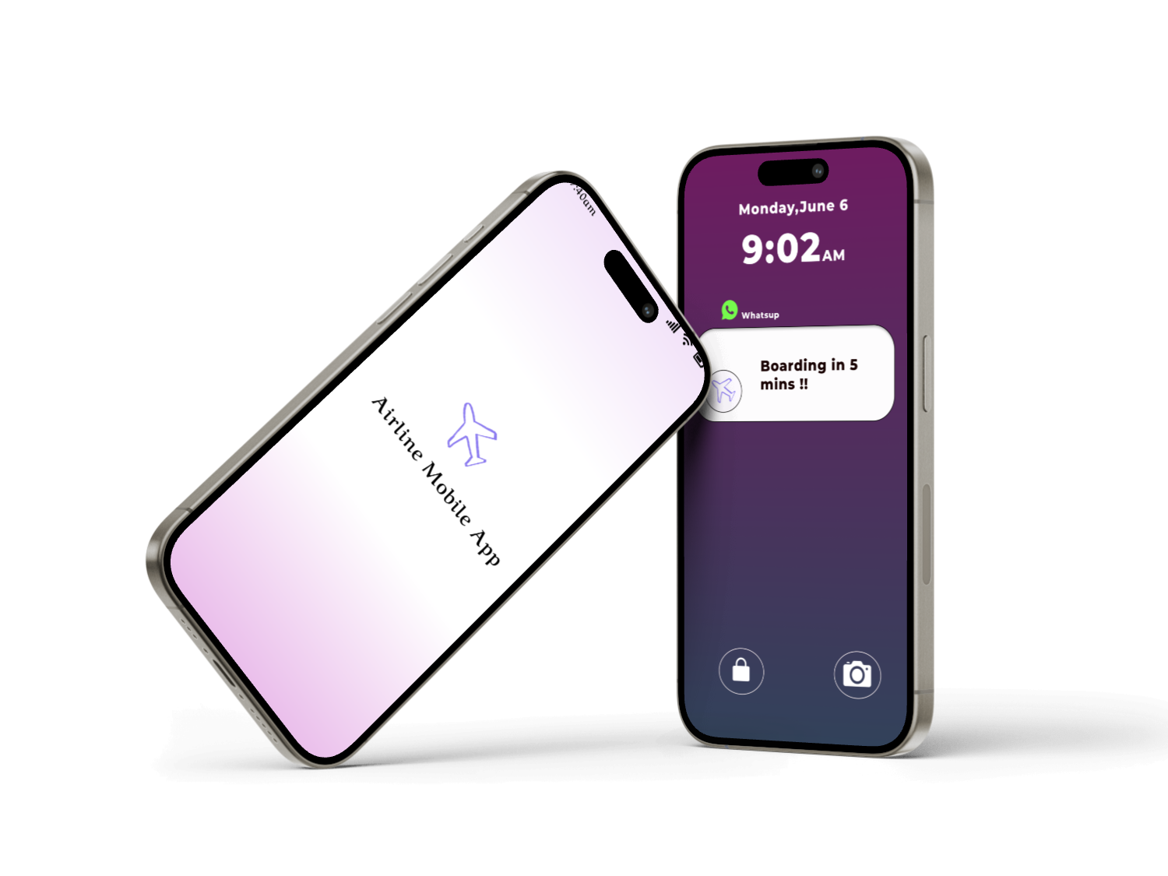
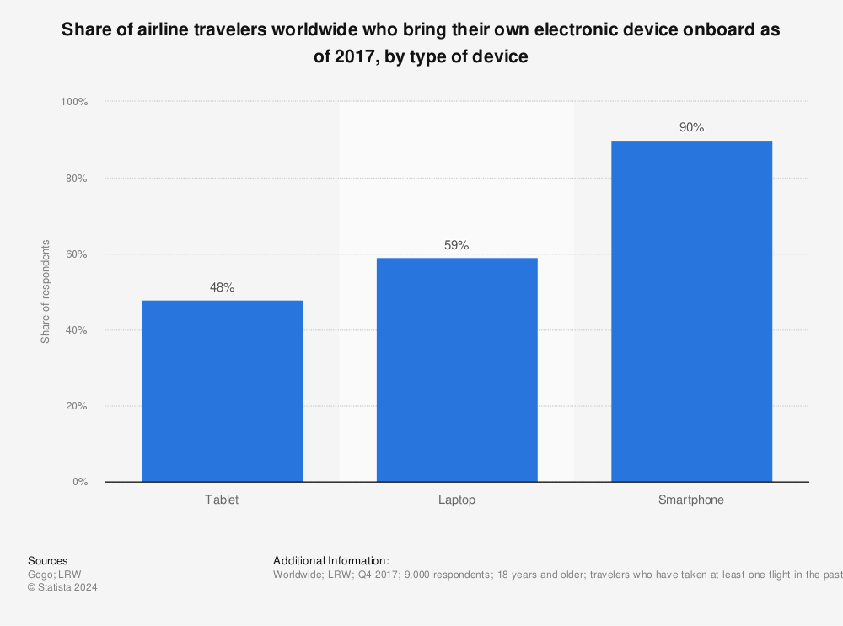
Data Science Recommendation and solution
Our Solution
Airline Mobile App
Why Airline Mobile App?
90% air travellers use smartphones onboard
Notes:
We would like to introduce our latest innovation tailored specifically for today's tech-savvy traveler: our Airline Mobile App. In today's digital age, 90% of airline travelers use smartphones onboard, and our app is designed to enhance their travel experience directly from their preferred device.

Slide 41
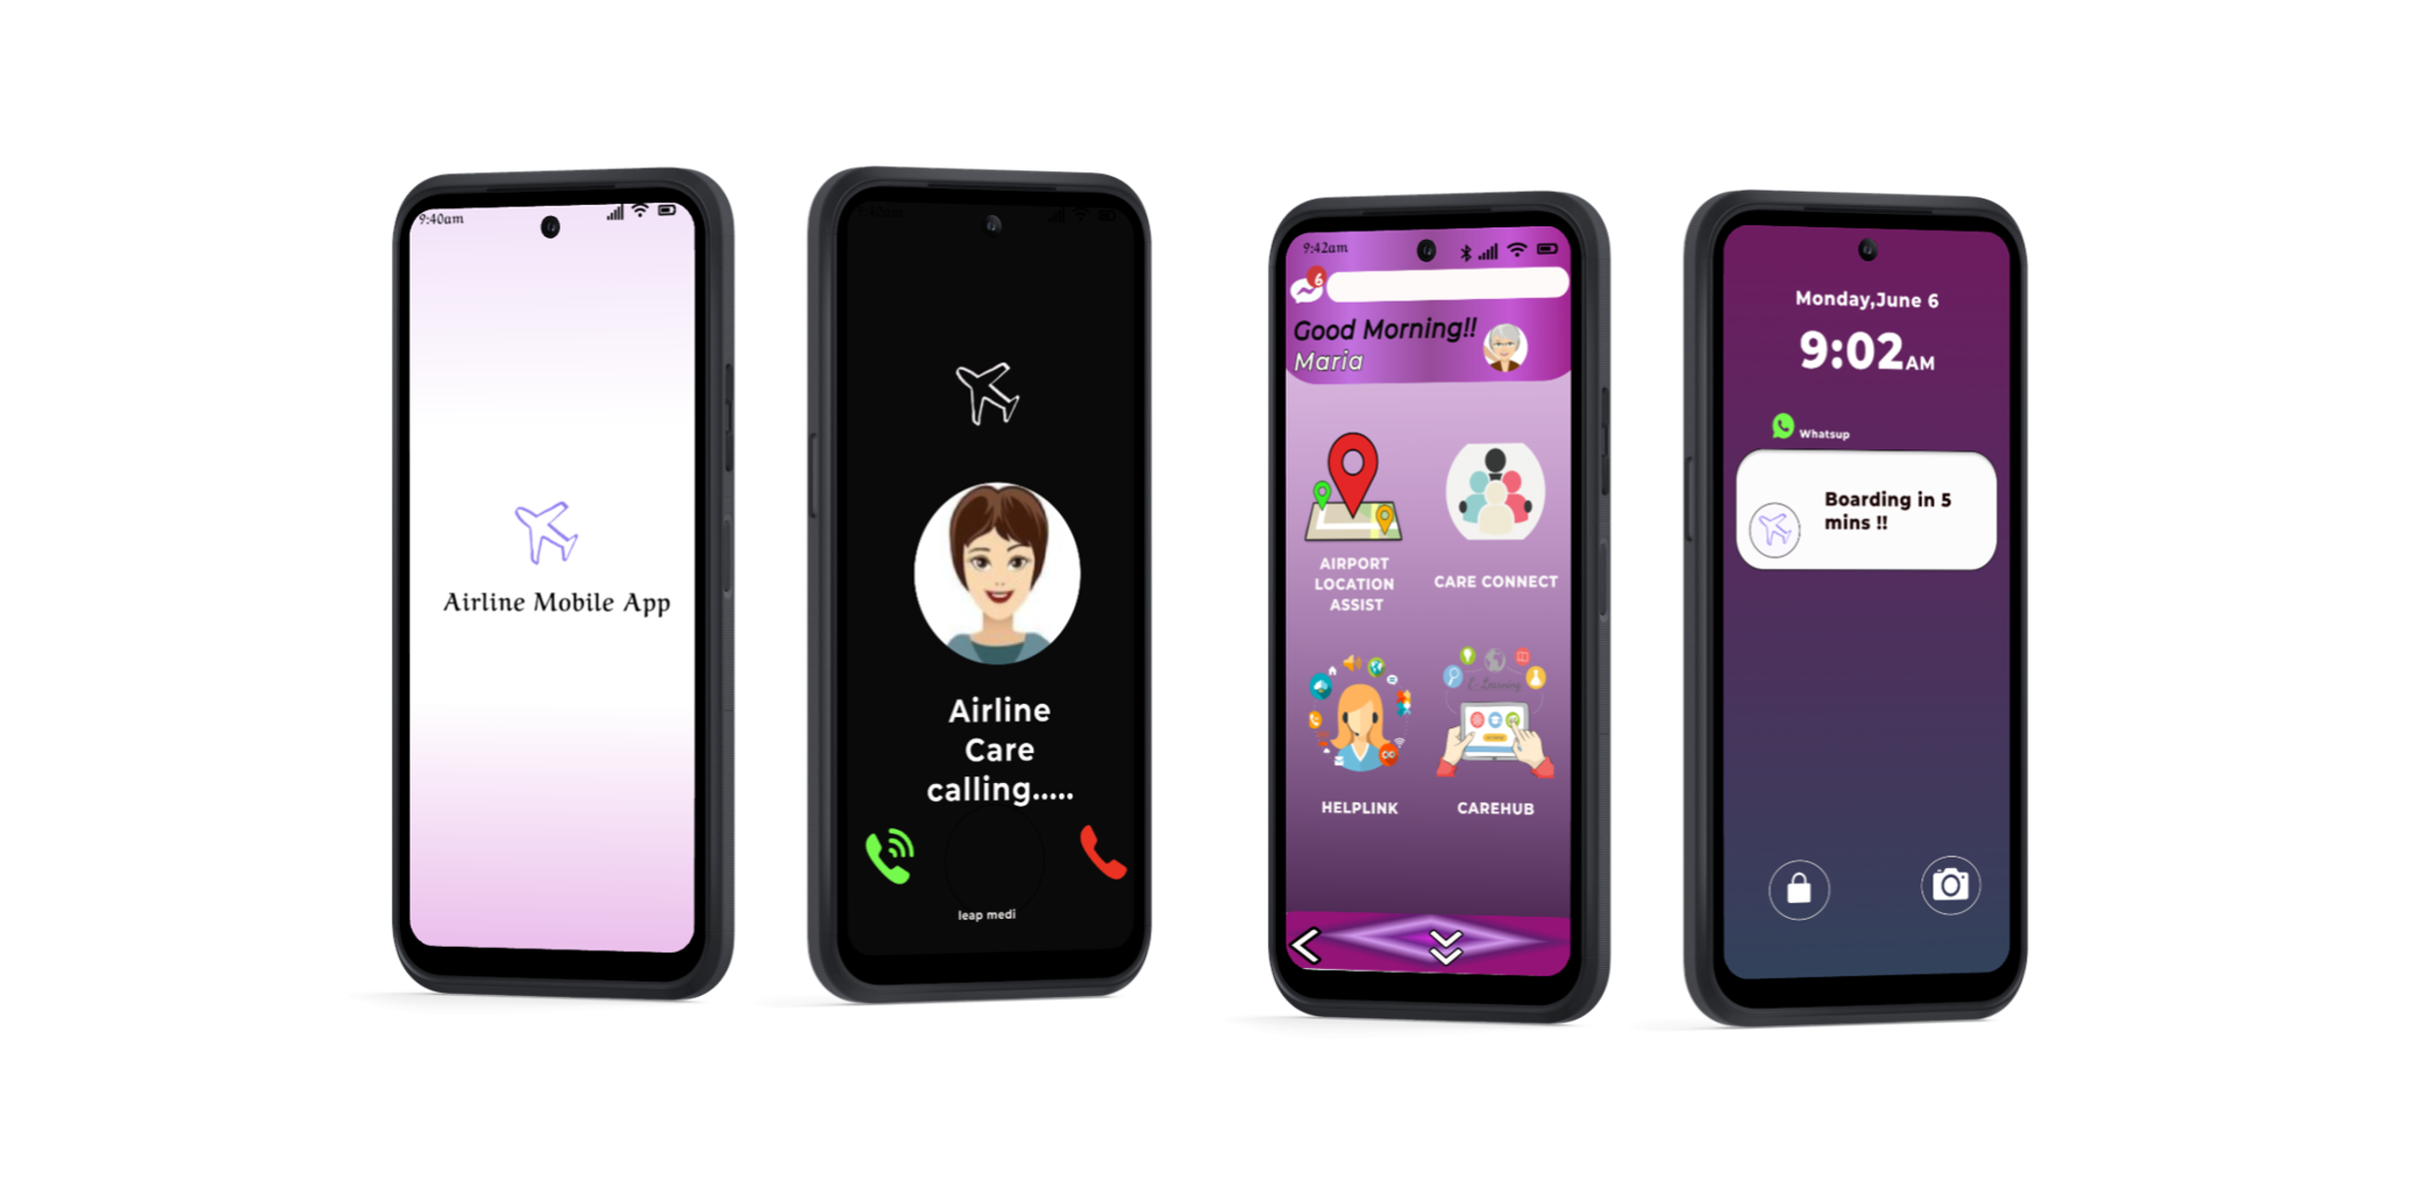
Recommendations and Solutions
To increase profitability, we are leveraging technology to improve service delivery. One of our solutions includes implementing a mobile app to address pain points identified in dissatisfied customers from cluster 0 (grouped via frequent pattern mining).
The airline mobile app prototype features:
Online boarding
Customer service (email, whatsupchats, and calls)
Service upgrades (Wi-Fi, seat selection, etc.)
Airline guide
Membership promotions
Airport maps and services
Customer information details (personal/business travel)
Personalized promotions
This approach aims to enhance customer satisfaction and drive sustainable growth.
Notes:
Next I will introduce more functions from this app.
Our latest updates specifically target pain points identified through detailed data analysis, focusing on cluster 0 customers who have shown higher levels of dissatisfaction.
The upgraded features of our app include:
Online Boarding: Streamlining the boarding process to make it faster and more intuitive.
Customer Service Enhancements: Offering support through various channels like email, WhatsApp, and direct calls, ensuring help is just a tap away.
Service Upgrades: Providing options for Wi-Fi and seat selection to enhance in-flight comfort.
Comprehensive Airline Guide: Everything from membership promotions to detailed airport maps and service information is now at your fingertips.
Personalized Promotions: Tailored offers that cater to individual travel needs, whether for leisure or business.

Slide 42
Data Governance
PROBLEM ANALYSIS
DATA SCIENCE TASK
RECOMMENDATION AND SOLUTION
COST ANALYSIS
RISK AND MITIGATION
NAÏVE APPROACH

Slide 43
Cost & Profit Analysis: Solution
Category | Cost (USD) | Year 0 | Year 1 | Year 2 | Year 3
Outsource | 3x Backend Developer (4 mths @ $3,000/mth) | $36,000 | - | - | -
 | 2x Frontend Developer (UI) (4 mths @ $3,000/mth) | $24,000 | - | - | -
In-house Development | 1x Tech Lead cum PM (4 mths @ $15,000/mth | $60,000 | - | - | -
 | 1x Quality Analyst (4 mths @ $7,000/mth) | $28,000 | - | - | -
 | 6x Jr Full Stack Developer (10 mths @ $5,000/mth) | $300,000 | $307,200 | $314,573 | $323,381
 | 7x Jr Quality Analyst (8 mths @ $4,000/mth) | $224,000 | $229,376 | $234,881 | $241,458
Data Cost | 450 TB Azure DB Service ($0.5/mth) | $2,700 | $2,700 | $2,700 | $2,700
 | Azure Notification Hub-Standard ($267.5/mth) | $3,210 | $3,210 | $3,210 | $3,210
 | Total | $677,910 | $542,486 | $555,364 | $570,749
Notes:
This chart shows how much the airline spent this year, broken down into three areas, Outsource, In-house Development and Data Cost.

Slide 44
Cost & Profit Analysis: Mobile App Revenue
 | Year 0 | Year 1 | Year 2 | Year 3 | Total
Unit Sales | 17,180 | 17,180 | 34,360 | 34,360 | 103,080
Membership Price/year (USD) | $45 | $40 | $40 | $40 | -
Revenue (USD) | $773,100 | $687,200 | $1,374,400 | $1,374,400 | $4,209,100
*Assuming 2.5% inflation rate, subject to change by airline company​​
Notes:
This one shows the income we earn through the mobile app.

Slide 45
Cost & Profit Analysis
 | Year 0 | Year 1 | Year 2 | Year 3 | Total
Revenue | $773,100 | $687,200 | $1,374,400 | $1,374,400 | $4,209,100
Cost | ($677,910) | ($542,586) | ($555,364) | ($570,749) | ($2,346,508)
Investment Gain | $95,190 | $144,714 | $819,036 | $803,651 | $1,862,592
ROI | 79.38%
Annualized ROI | 15.73%
*Assuming 2.5% inflation rate, subject to change by airline company​
Notes:
With the cost and the revenue from the mobile app, we can roughly calculate the Return on Investment in recent years.

Slide 46
Cost & Profit Analysis: Formula
Investment Gain = Revenue from Investment – Cost of Investment
Total Investment Gain
Return on Investment % =
Total Cost of Investment
Annualized Return on Investment % = ((1 + ROI)^{1/n}) - 1
Notes:
We calculate ROI by using these formulas

Slide 47
Data Governance
PROBLEM ANALYSIS
DATA SCIENCE TASK
RECOMMENDATION AND SOLUTION
COST ANALYSIS
RISK AND MITIGATION
NAÏVE APPROACH

Slide 48
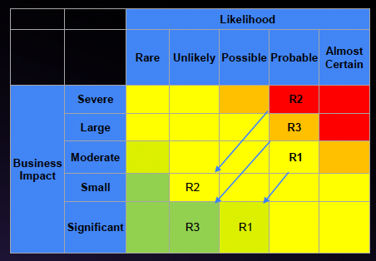
RISK AND MITIGATION
 | RISK | MITIGATION
R1 | The Airline mobile app can't help if people are not proactive to use it. | Advice is to keep people active on app with various features
R2 | People may worry about privacy because different users use the app, and it collects data for features like HelpLink(customer support) and CareHub(airport location support). They wonder how Airline will use and keep this data safe, especially if it's stored on public cloud services. | Implement robust data encryption protocols for transit and storage. Adhere strictly to relevant data protection regulations. Conduct regular audits and penetration tests to identify and rectify vulnerabilities. Enforce stringent access controls on public cloud systems to enhance data security. Provide comprehensive staff training on best practices of data privacy.
R3 | Users, especially older adults might get confused by the many features on the app. They might not know which feature is best for them. | Developing a user-centric design with distinct roles (old adults, young adults, etc). Dynamic feature population upon login tailors the experience for each user role. Offer customizable feature selection to enhance usability and engagement.
BUSINESS IMPACT
Notes:
Of course there are some risks associated with our program, the three most significant being the following.

Slide 49
PROBLEM ANALYSIS
NAÏVE APPROACH
DATA SCIENCE TASK
RECOMMENDATION
SOLUTION
COST ANALYSIS
DATA GOVERNANCE

Slide 50
DATA GOVERNANCE IN BUSINESS AND BIAS
Solution: Ensure ethical practices by being transparent about data collection methods, usage, and securing informed consent from individuals involved.
Data Bias
Issue: The dataset may contain biases.
Solution: Regularly audit the dataset to ensure it comprehensively reflects the business's customer demographic.
Data Obsolescence
Issue: The dataset may become outdated over time.
Solution: Refresh the dataset biannually or when there are major changes in the business strategy as part of the company's data management protocols.
Data Security
Issue: There is a risk of unauthorized data access or theft.
Solution: Deploy advanced security measures such as data encryption, strict access controls, and network segmentation to protect data.
Data Privacy
Issue: There is a risk of data misuse, which could result in financial and reputational harm.
Solution: Protect privacy by minimizing data collection, anonymizing sensitive information, using robust password protection, and conducting periodic privacy audits.
Data Ethics
Issue: Ethical concerns regarding how data is collected and used.
Notes:
We approach data governance by looking at five areas, Data Bias, Data Obsolescence, Data Security, Data Privacy, and Data Ethics.This can be comprehensive.like data security： There is a risk of unauthorized data access or theft.So we can deploy advanced security measures such as data encryption, strict access controls, and network segmentation to protect data.

Slide 51
CONCLUSION
PROBLEM ANALYSIS
DATA SCIENCE TASK
SOLUTION AND RECOMMENDATION
From Our Data Science Tasks We Categorized the Customers , We Are Able To provide Solutions targeting to solve these customers Pain Points And identify Opportunities for The Company To Gain profitability.
Mapped Customer Journey And Airline company And Realised The significance Of Satisfaction of customers in the Company's Profit trends .
Notes:
So above, We mapped Customer Journey And Airline company And Realised The significance Of Satisfaction of customers in the Company's Profit trends.
From Our Data Science Tasks We Categorized the Customers , We Are Able To provide Solutions targeting to solve these customers Pain Points And identify Opportunities for The Company To Gain profitability.
For the solution, We try to implement a mobile app to enhance customer satisfaction and drive sustainable growth.

Slide 52
THANKS!
Notes:
That’s all our group presentation. Thanks for listening.

Slide 53
REFERENCES
https://www.kaggle.com/datasets/teejmahal20/airline-passenger-satisfaction
https://www.kaggle.com/datasets/johndddddd/customer-satisfaction
https://www.statista.com/statistics/564717/airline-industry-passenger-traffic-globally/
https://www.iata.org/en/iata-repository/publications/economic-reports/airline-revenue-to-surpass-pre-pandemic-levels-in-2023/

Slide 54
APPENDIX

Slide 55
Business Assumptions
Customer Satisfaction Drives Loyalty: Higher satisfaction levels are likely to increase customer retention and repeat business.
Service Quality is Critical: Improvements in specific service areas (e.g., in-flight service, check-in process) directly impact overall satisfaction.
Demographics Influence Satisfaction: Passenger demographics (e.g., age, travel frequency) affect satisfaction levels, requiring targeted strategies for different segments.
Operational Efficiency Matters: Efficient handling of flights and passenger services reduces dissatisfaction related to delays and inconvenience.
Feedback is Indicative: Frequent patterns in feedback highlight areas needing immediate attention and potential service innovations.

Slide 56
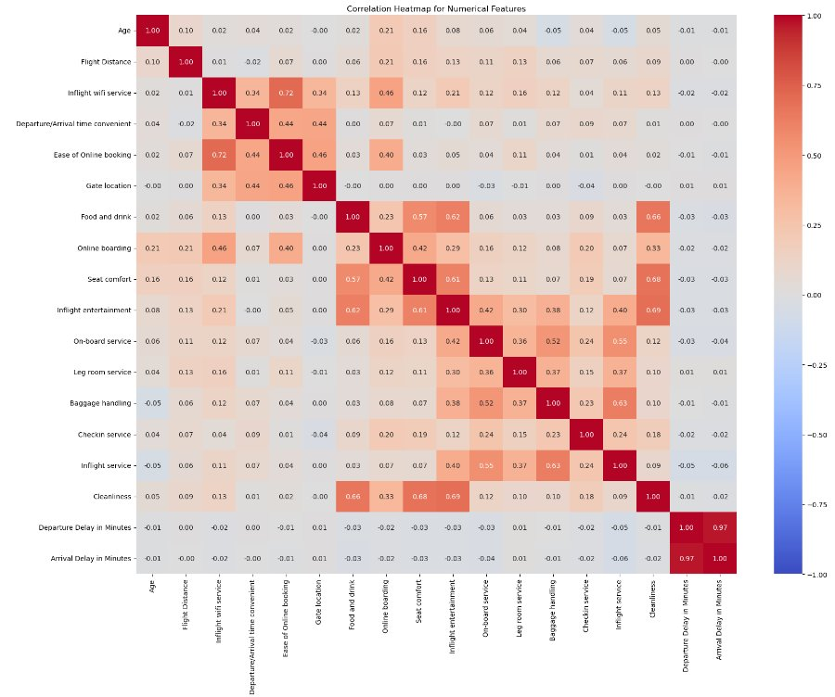
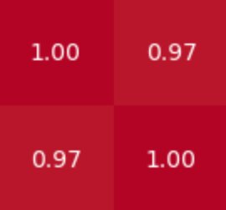
Data Science Task: Data cleaning
Correlation​
Dropped column Arrival in Minutes as both columns are highly correlated​

Slide 57
AIRLINE MOBILE APP
Year 0
Role | Units | Cost/Month(USD) | No.of Months | Total Cost(USD)
Option A- Intern (one-time cost)
Backend Developer - Intern | 1 | $3,000.00 | 4 | $12,000.00
Frontend Developer(UI) - Intern | 1 | $3,000.00 | 4 | $12,000.00
 |  |  |  | $24,000.00
OR
Option B-Outsource (one-time cost)
Backend Developer | 1 | $12,000.00 | 4 | $48,000.00
Frontend Developer(UI) | 1 | $10,000.00 | 4 | $40,000.00
 |  |  |  | $88,000.00
In-House(Development, Operations & Maintenance)-Upto 1 Years
Tech Lead cum PM | 1 | $15,000.00 | 3 | $45,000.00
Quality Analyst | 1 | $5,000.00 | 3 | $15,000.00
Jr FullStack Developer | 6 | $5,000.00 | 10 | $300,000.00
Jr Quality Analyst | 7 | $4,000.00 | 8 | $224,000.00
 |  |  |  | $584,000.00
Data Cost - Upto 1 Year
Azure DB Service - 450 TB | 450 | $0.50 | 12 | $2,700.00
Azure Notification Hub-Standard | NA | $267.50 | 12 | $3,210.00
 |  |  |  | $5,910.00
Total Cost |  |  | Min-Option A | $613,910.00
 |  |  | Max-Option B | $677,910.00
Passengers traffic in | 171800000
for southwest airline
Year 0
Year 0 | Total Cost(USD) | Units Sale per year | Unit Price/Year (USD) | Revenue(USD)
AIRLINE App Membership (Assuming 1 in 10000 will purchase) | $677,910.00 | 17180 | $45.00 | $773,100.00
Revenue |  |  |  | $773,100.00
Investment Gain |  |  |  | $95,190.00
Return on Investment (ROI) |  |  |  | 14.04%

Slide 58
YEAR 1 – COST & REVENUE
Year 1
Role | Units | Inflation Rate | Cost/Month(USD) | No.of Months | Total Cost(USD)
In-House(Development, Operations & Maintenance)
Jr FullStack Developer | 6 | 2.40% | $5,120.00 | 10 | $307,200.00
Jr Quality Analyst | 7 |  | $4,096.00 | 8 | $229,376.00
 |  |  |  |  | $536,576.00
Data Cost
Azure DB Service - 450 TB | 450 |  | $0.50 | 12 | $2,700.00
Azure Notification Hub-Standard | NA |  | $267.50 | 12 | $3,210.00
 |  |  |  |  | $5,910.00
 |  |  |  | Total | $542,486.00
Year 1
Year 1 | Total Cost(USD) | Units Sale per year | Unit Price/Year (USD) | Revenue (USD)
Airline App Membership (Assuming 1 in 10000 will purchase) | $542,486.00 | 17180 | $40.00 | $687,200.00
Revenue |  |  |  | $687,200.00
Investment Gain |  |  |  | $144,714.00
Return on Investment (ROI) |  |  |  | 26.68%

Slide 59
YEAR 2– COST & REVENUE
YEAR 2– COST & REVENUE
Role | Units | Inflation Rate | Cost/Month(USD) | No.of Months | Total Cost(USD)
In-House(Development, Operations & Maintenance)
Jr Full Stack Developer | 6 | 2.40% | $5,242.88 | 10 | $314,572.80
Jr Quality Analyst | 7 |  | $4,194.30 | 8 | $234,881.02
 |  |  |  |  | $549,453.82
Data Cost
Azure DB Service - 450 TB | 450 |  | $0.50 | 12 | $2,700.00
Azure Notification Hub-Standard | NA |  | $267.50 | 12 | $3,210.00
 |  |  |  |  | $5,910.00
 |  |  |  | Total | $555,363.82
YEAR 2– COST & REVENUE
YEAR 2– COST & REVENUE | Total Cost(USD) | Units Sale per year | Unit Price/Year (USD) | Revenue (USD)
Airline App Membership (Assuming 2 in 10000 will purchase) | $555,363.82 | 34360 | $40.00 | $1,374,400.00
Revenue |  |  |  | $1,374,400.00
Investment Gain |  |  |  | $819,036.18
Return on Investment (ROI) |  |  |  | 147.48%

Slide 60
YEAR 3– COST & REVENUE
YEAR 3– COST & REVENUE
Role | Units | Inflation Rate | Cost/Month(USD) | No.of Months | Total Cost(USD)
In-House(Development, Operations & Maintenance)
Jr FullStack Developer | 6 | 2.80% | $5,389.68 | 10 | $323,380.84
Jr Quality Analyst | 7 |  | $4,311.74 | 8 | $241,457.69
 |  |  |  |  | $564,838.53
Data Cost
Azure DB Service - 500 TB | 450 |  | $0.50 | 12 | $2,700.00
Azure Notification Hub-Standard+ Add on | NA |  | $267.50 | 12 | $3,210.00
 |  |  |  |  | $5,910.00
 |  |  |  | Total | $570,748.53
YEAR 3– COST & REVENUE
YEAR 3– COST & REVENUE | Total Cost(USD) | Units Sale per year | Unit Price/Year (USD) | Revenue (SGD)
Airline App Membership (Assuming 2 in 10000 will purchase) | $570,748.53 | 34360 | $40.00 | $1,374,400.00
Revenue |  |  |  | $1,374,400.00
Investment Gain |  |  |  | $803,651.47
Return on Investment (ROI) |  |  |  | 140.81%

Slide 61
Understanding challenges
Problems at hand
Core Challenges identified
Understanding and Improving Passenger Satisfaction
To Analyse various factors influencing the overall passenger experience (e.g., seat comfort, inflight entertainment, food quality, cabin crew service, cleanliness) to accurately predict and enhance satisfaction levels.
Effective Customer Segmentation
Accurately segment passengers into meaningful groups based on their behaviour and satisfaction levels to tailor marketing strategies and service offerings, enhancing overall satisfaction and customer loyalty.
Passenger satisfaction Prediction
Accurately predicting passenger satisfaction poses challenges in data integration and model interpretability. Integrating diverse data sources containing complex features like seat comfort and entertainment quality is challenging. Additionally, interpreting predictions from complex models may hinder actionable insights.
Customer Segmentation
Effectively segmenting passengers into meaningful groups faces challenges in segmentation accuracy and data dimensionality. Achieving accurate segmentation based on behaviour and satisfaction levels is critical, but dealing with high-dimensional data and selecting relevant features is difficult. Moreover, interpreting and adapting clustering results to dynamic passenger preferences pose additional hurdles.

Slide 62
